Slide 1
Improved Lower Bounds for Pointer Chasing via Gadgetless Lifting
Xinyu Mao, Guangxu Yang, and Jiapeng Zhang
University of Southern California
2024/05/24 @Complexity Network

Slide 2
Round Communication Trade-Off and Pointer Chasing

Slide 3
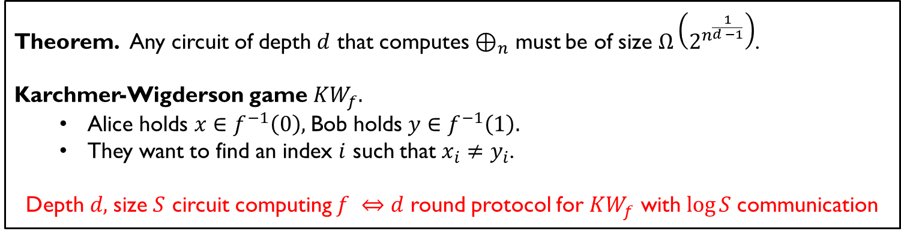
Round communication trade-off
Do more rounds of interaction allow
two parties to solve problems with less communication?
Example. Parity and constant-depth circuits
Theorem. Any circuit of depth $d$ that computes $⊕_{n}$ must be of size $Ω\left(2^{n^{\frac{1}{d −1}}}\right)$.
Karchmer-Wigderson game $KW_{f}.$
Alice holds $x∈f^{−1}\left(0\right),$Bob holds $y∈f^{−1}\left(1\right).$
They want to find an index $i$ such that $x_{i}≠y_{i}$.
Depth $d,$size $S$ circuit computing $f ⇔d$ round protocol for $KW_{f}$ with $\log{S}$communication
Corollary. Any $d$-round protocol that computes $KW_{⊕_{n}}$ must communicate $Ω\left(n^{\frac{1}{d −1}}\right)$ bits.

Slide 4


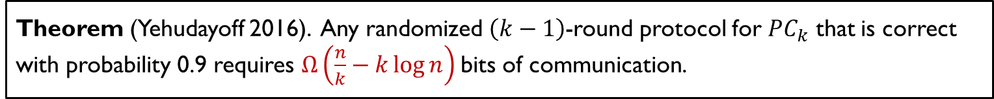
The pointer chasing problem
$$f_{A} f_{B}$$
Alice holds $f_{A}∈{\left[n\right]}^{n}$, Bob hold $f_{B}∈{\left[n\right]}^{n}.$
The $k$ step pointer chasing function $PC_{k}:{\left[n\right]}^{n}×{\left[n\right]}^{n}→\left\{0,1\right\}$
$pt_{0} ≔1$
for odd $r$’s, $pt_{r}≔f_{A}\left(pt_{r −1}\right)$
for even $r$’s, $pt_{r}≔f_{B}\left(pt_{r−1}\right)$
$PC_{k}\left(f_{A},f_{B}\right)≔pt_{k} mod 2$.
Theorem (Yehudayoff 2016). Any randomized $\left(k−1\right)$-round protocol for $PC_{k}$ that is correct with probability 0.9 requires $Ω\left(\frac{n}{k}−k\log{n}\right)$bits of communication.
This work. $Ω\left(\frac{n}{k}\right)$ lower bound via a completely different, combinatorial proof.

Slide 5
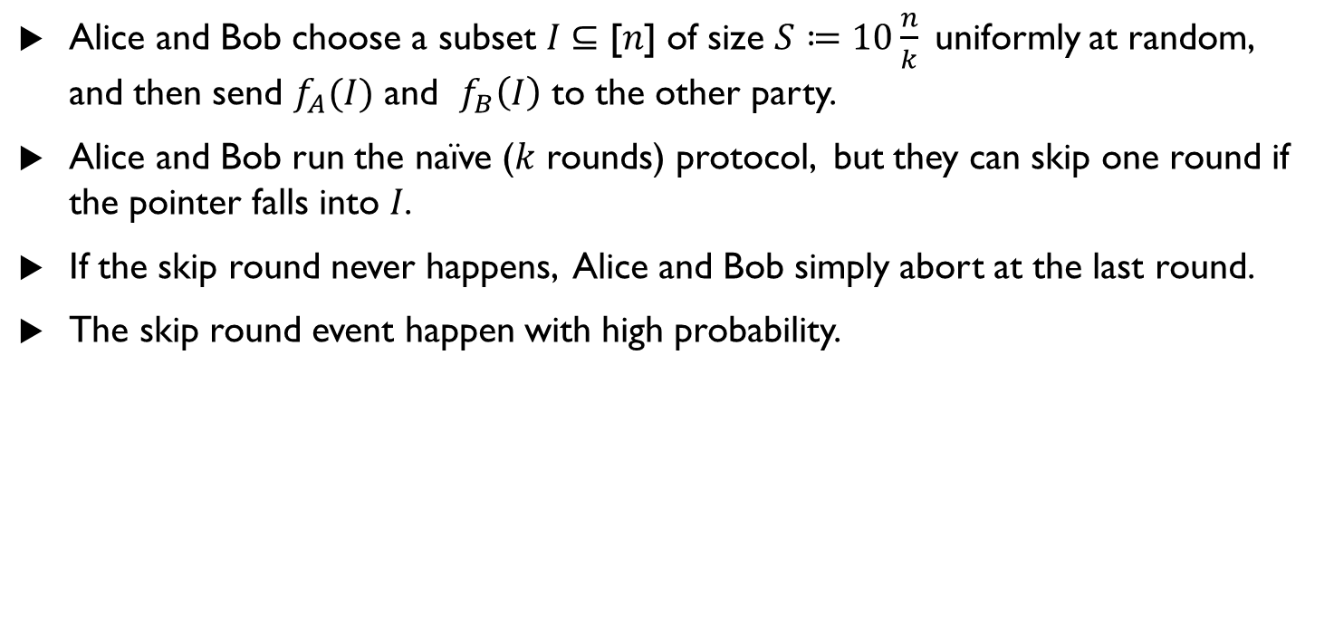
A simple class of protocols for pointer chasing
Alice and Bob choose a subset 𝐼 ⊆ [𝑛] of size $S≔10\frac{n}{k}$uniformly at random, and then send $f_{A}(I)$ and $f_{B}\left(I\right)$ to the other party.
Alice and Bob run the naïve ($k$ rounds) protocol, but they can skip one round if the pointer falls into 𝐼.
If the skip round never happens, Alice and Bob simply abort at the last round.
The skip round event happen with high probability.

Slide 6
Gadgetless Lifting

Slide 7
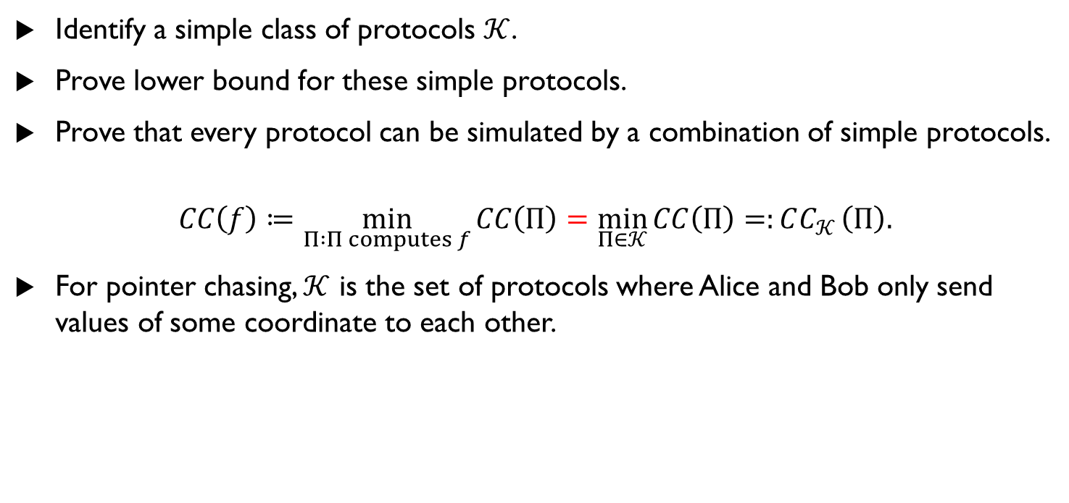
Gadgetless lifting
Identify a simple class of protocols $𝒦$.
Prove lower bound for these simple protocols.
Prove that every protocol can be simulated by a combination of simple protocols.
$$CC\left(f\right)≔\min_{Π :Π computes f}{CC\left(Π\right)}=\min_{Π∈𝒦}{CC\left(Π\right)=:CC_{𝒦}}\left(Π\right).$$
For pointer chasing, $𝒦$ is the set of protocols where Alice and Bob only send values of some coordinate to each other.

Slide 8
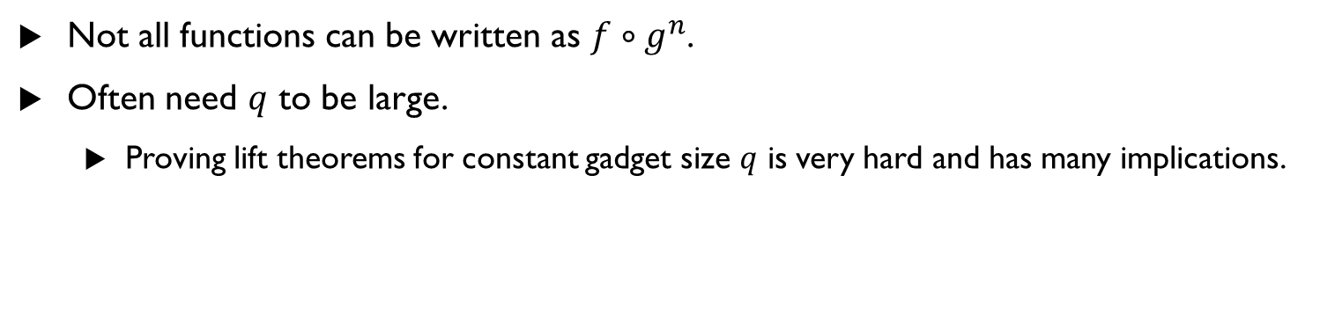

Lifting theorems
Let $g:{\left\{0, 1\right\}}^{q}×{\left\{0,1\right\}}^{q}→\left\{0,1\right\}$ be a gadget function.
Consider functions of the form $f∘g^{n}$ for some outer function $f:{\left\{0,1\right\}}^{n}→\left\{0,1\right\},$
$$\left(f∘g^{n}\right)\left(\left(x_{1},y_{1}\right),…, \left(x_{n}y_{n}\right)\right)≔f\left(g\left(x_{1},y_{1}\right),…, g\left(x_{n},y_{n}\right)\right).$$
$CC\left(f∘g^{n}\right)=Ω\left(Q\left(f\right)⋅q\right),$ where $Q(f)$ denotes the query complexity of $f$.
Not all functions can be written as $f∘g^{n}$.
Often need $q$ to be large.
Proving lift theorems for constant gadget size $q$ is very hard and has many implications.

Slide 9
Decomposition and Sampling Process

Slide 10

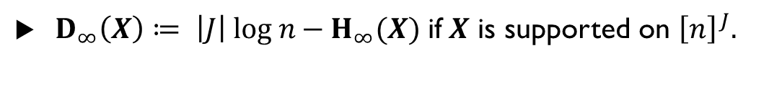

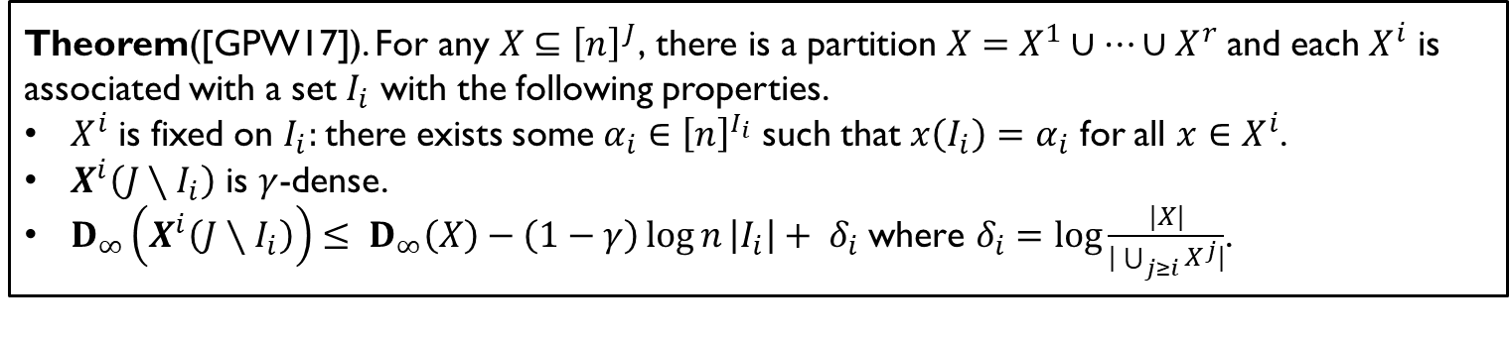
Density restoring partition
Def. For a random variable $X$, its min-entropy is defined as $H_{∞}\left(X\right) ≔\log{\frac{1}{\max_{x}{\operatorname{Pr}\left[X=x\right]}}}.$
Def. We say a random variable $X$over ${ \left[n\right]}^{J}$ is $γ$-dense if $H_{∞}\left(X\left(I\right)\right)≥γ\log{n} \left|I\right|$ for all $I⊆J.$
For a set$X, X≔$uniform distribution over $X$.
Theorem([GPW17]). $\text{For} \text{any} X⊆{\left[n\right]}^{J}\text{,} \text{there} \text{is} \text{a} \text{partition} X=X^{1}∪⋯∪X^{r}$and each $X^{i}$ is associated with a set $I_{i}$ with the following properties.
$X^{i}$ is fixed on $I_{i}:$there exists some $α_{i}∈{\left[n\right]}^{I_{i}}$ such that $x\left(I_{i}\right)=α_{i}$ for all $x∈X^{i}$.
$X^{i}\left(J∖I_{i}\right)$ is $γ$-dense.
$D_{∞}\left(X^{i}\left(J∖I_{i}\right)\right)≤ D_{∞}\left(X\right)−\left(1−γ\right)\log{n}\left|I_{i}\right|+ δ_{i} \text{where} δ_{i}=\log{\frac{|X|}{|\bigcup_{j≥i}{X^{j}}|}}$.
$D_{∞}\left(X\right)≔ \left|J\right| log n{−{ H}_{∞}(X)}$ if$X$ is supported on ${\left[n\right]}^{J}.$
$$1\left|1\right|4\left|5\right|1\left|4\right|1|$$
dense
$$I_{i}$$

Slide 11
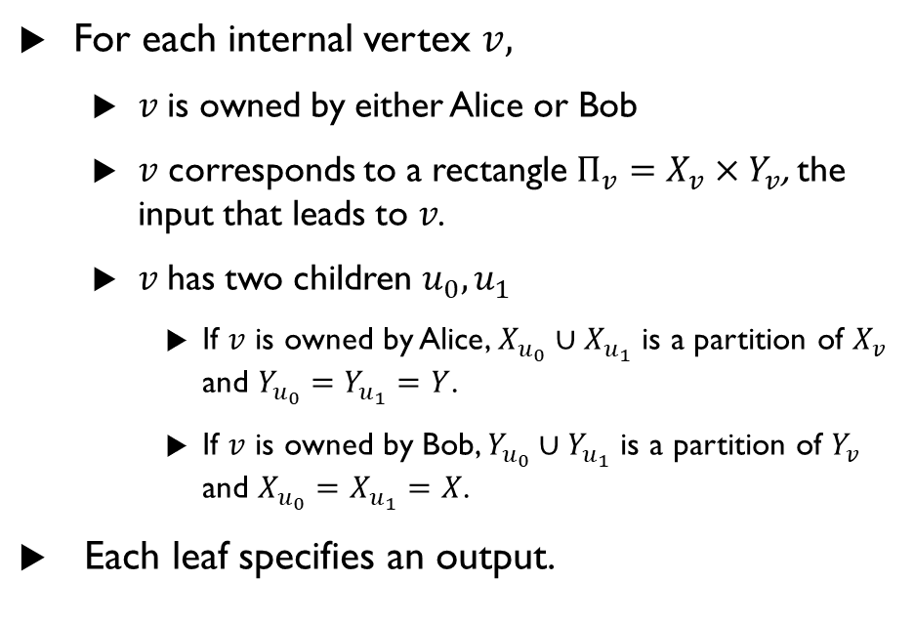
Protocol tree
A
For each internal vertex $v,$
$v$is owned by either Alice or Bob
$v$ corresponds to a rectangle $Π_{v}=X_{v}×Y_{v}$, the input that leads to $v$.
$v$has two children $u_{0},u_{1}$
If $v$ is owned by Alice, $X_{u_{0}}∪X_{u_{1}}$ is a partition of $X_{v}$ and $Y_{u_{0}}=Y_{u_{1}}=Y$.
If $v$ is owned by Bob, $Y_{u_{0}}∪Y_{u_{1}}$ is a partition of $Y_{v}$ and $X_{u_{0}}=X_{u_{1}}=X$.
Each leaf specifies an output.
0
1
A
B
0
1
0
1
B
B
A
A

Slide 12
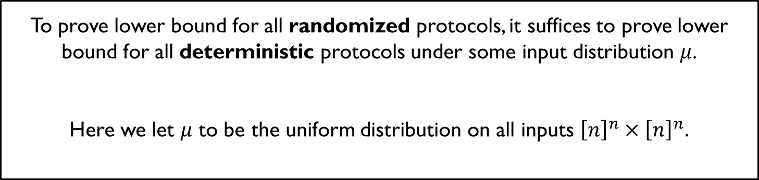
Yao’s min-max principle
To prove lower bound for all randomized protocols, it suffices to prove lower bound for all deterministic protocols under some input distribution $μ$.
Here we let $μ$ to be the uniform distribution on all inputs ${\left[n\right]}^{n}×{\left[n\right]}^{n}.$

Slide 13

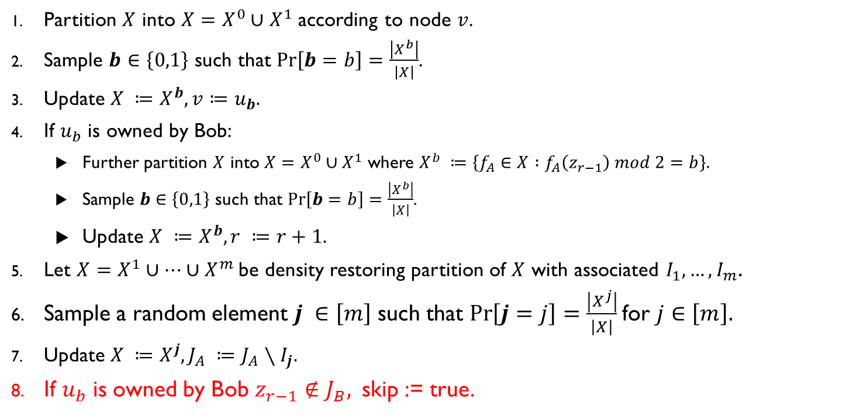
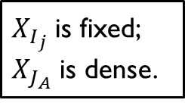
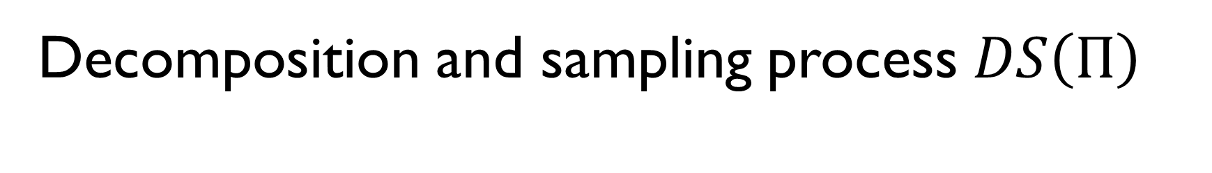
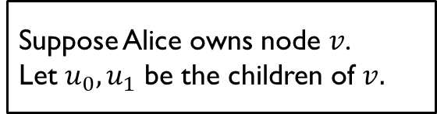
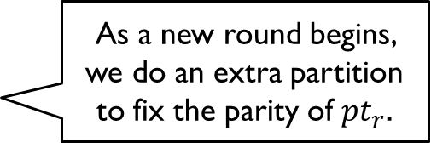
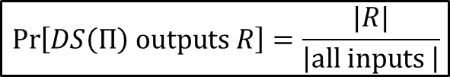
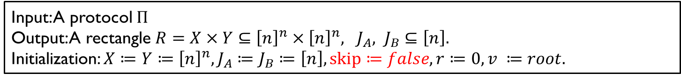

Decomposition and sampling process $DS\left(Π\right)$
Input: A protocol $Π$
Output: A rectangle $R=X×Y⊆{\left[n\right]}^{n}×{\left[n\right]}^{n}, {J_{A}, J}_{B}⊆\left[n\right].$
Initialization: $X≔Y≔{\left[n\right]}^{n}, J_{A}≔J_{B}≔\left[n\right], skip≔false, r≔0, v ≔root.$
$$\operatorname{Pr}\left[DS\left(Π\right) outputs R\right]=\frac{|R|}{\left|all inputs \right|}$$
Partition $X$ into $X=X^{0}∪X^{1}$ according to node $v$.
Sample $b∈\left\{0,1\right\}$ such that $\operatorname{Pr}\left[b=b\right]=\frac{\left|X^{b}\right|}{\left|X\right|}$.
Update $X ≔X^{b}, v≔u_{b}.$
If $u_{b}$ is owned by Bob:
Further partition $X$ into $X=X^{0}∪X^{1}$ where $X^{b} ≔\left\{f_{A}∈X :f_{A}\left(z_{r−1}\right) mod 2=b\right\}.$
Sample $b∈\left\{0,1\right\}$ such that $\operatorname{Pr}\left[b=b\right]=\frac{\left|X^{b}\right|}{\left|X\right|}$.
Update $X ≔X^{b}, r ≔r+1.$
Let $X=X^{1}∪⋯∪X^{m}$be density restoring partition of $X$ with associated $I_{1},…, I_{m}$.
Sample a random element $j ∈\left[m\right]$ such that $\operatorname{Pr}\left[j=j\right]=\frac{\left|X^{j}\right|}{\left|X\right|}$for $j∈\left[m\right].$
Update $X ≔X^{j}, J_{A} ≔J_{A}∖I_{j}.$
If $u_{b}$ is owned by Bob $z_{r−1}∉J_{B},$ skip := true.
Suppose Alice owns node $v$.
Let $u_{0},u_{1}$ be the children of $v.$
As a new round begins, we do an extra partition to fix the parity of $pt_{r}.$
$X_{I_{j}}$ is fixed; $X_{J_{A}}$ is dense.
$$1\left|1\right|4\left|5\right|1\left|4\right|1|$$
$J_{A}$

Slide 14
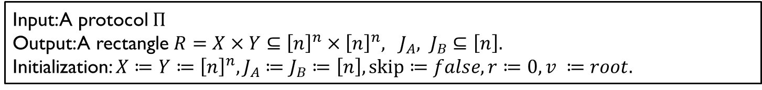
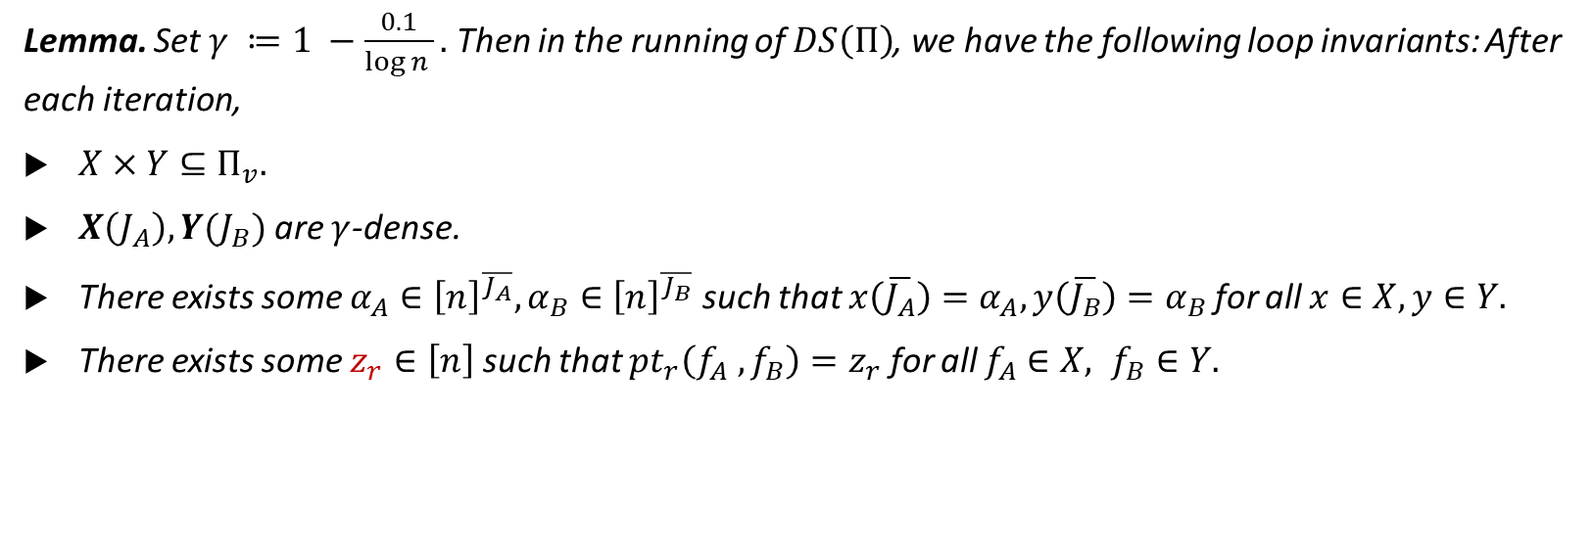
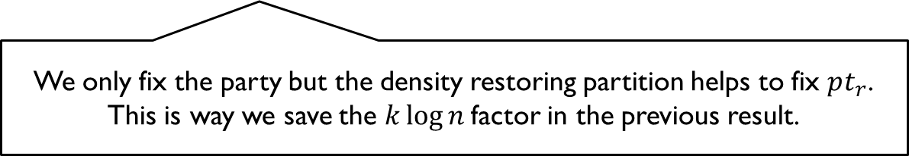
Loop invariant
Input: A protocol $Π$
Output: A rectangle $R=X×Y⊆{\left[n\right]}^{n}×{\left[n\right]}^{n}, {J_{A}, J}_{B}⊆\left[n\right].$
Initialization: $X≔Y≔{\left[n\right]}^{n}, J_{A}≔J_{B}≔\left[n\right], skip≔false, r≔0, v ≔root.$
Lemma. Set $γ ≔1 −\frac{0.1}{\log{n} }.$ Then in the running of $DS\left(Π\right)$, we have the following loop invariants: After each iteration,
$X×Y⊆Π_{v}.$
$X\left(J_{A}\right), Y(J_{B})$ are $γ$-dense.
There exists some $α_{A}∈{\left[n\right]}^{\overline{J_{A}}}, α_{B}∈{\left[n\right]}^{\overline{J_{B}}}$ such that $x\left(\overline{J_{A}}\right)=α_{A}, y\left(\overline{J_{B}}\right)=α_{B}$for all $x∈X, y∈Y.$
There exists some $z_{r}∈\left[n\right]$ such that $pt_{r}\left(f_{A} , f_{B}\right)=z_{r}$ for all $f_{A}∈X, f_{B}∈Y.$
We only fix the party but the density restoring partition helps to fix $pt_{r}$.
This is way we save the $k\log{n}$factor in the previous result.

Slide 15
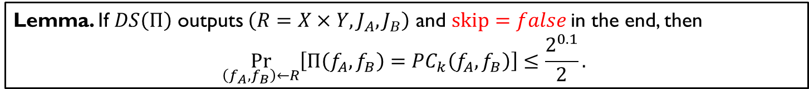


Relating accuracy and average fixed size
Input: A protocol $Π$
Output: A rectangle $R=X×Y⊆{\left[n\right]}^{n}×{\left[n\right]}^{n}, {J_{A}, J}_{B}⊆\left[n\right].$
Initialization: $X≔Y≔{\left[n\right]}^{n}, J_{A}≔J_{B}≔\left[n\right], skip≔false, r≔0, v ≔root.$
Lemma. If $DS\left(Π\right)$ outputs $\left(R=X×Y, J_{A}, J_{B}\right)$ and $skip=false$in the end, then
$$\underset{\left(f_{A}, f_{B}\right)←R}{Pr}\left[Π\left(f_{A},f_{B}\right)=PC_{k}\left(f_{A},f_{B}\right)\right]≤\frac{2^{0.1}}{2}.$$
Lemma. $\operatorname{Pr}\left[skip=true\right]≤ \frac{2^{0.1}}{n}⋅k⋅E\left[\left|\overline{J_{A}}\right|+\left|\overline{J_{B}}\right|\right].$
Union bound for $k$ rounds
If we can prove $E\left[\left|\overline{J_{A}}\right|+\left|\overline{J_{B}}\right|\right]=O\left(c\right)$, then we have
$$\frac{2^{0.1}}{n}⋅k⋅O\left(c\right)=Ω\left(1\right)⇒ c=Ω\left(\frac{n}{k}\right).$$

Slide 16
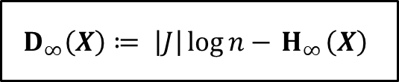
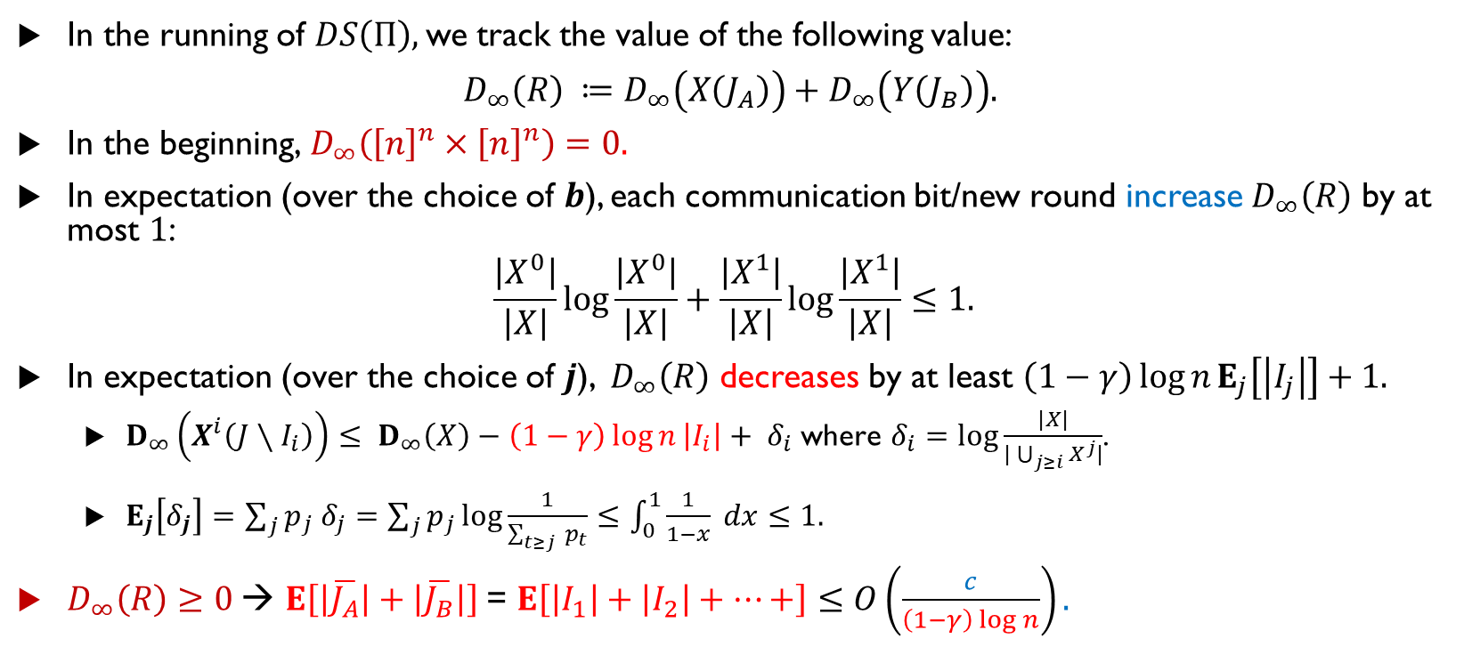
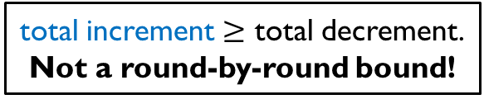
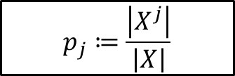
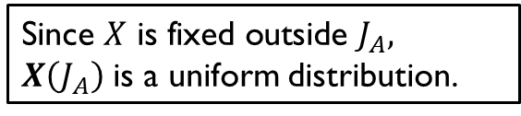
Average fixed size is bounded by communication: A density increment argument
In the running of $DS\left(Π\right),$we track the value of the following value:
$D_{∞}\left(R\right) ≔D_{∞}\left(X\left(J_{A}\right)\right)+D_{∞}\left(Y\left(J_{B}\right)\right).$
In the beginning,$D_{∞}\left({\left[n\right]}^{n}×{\left[n\right]}^{n}\right)=0.$
In expectation (over the choice of $b$), each communication bit/new round increase $D_{∞}\left(R\right)$ by at most $1$:
$$\frac{\left|X^{0}\right|}{\left|X\right|}\log{\frac{\left|X^{0}\right|}{\left|X\right|}+\frac{\left|X^{1}\right|}{\left|X\right|}\log{\frac{\left|X^{1}\right|}{\left|X\right|}}}≤1.$$
In expectation (over the choice of $j$), ${ D}_{∞}\left(R\right)$ decreases by at least $\left(1−γ\right)\log{n}E_{j}\left[\left|I_{j}\right|\right]+1.$
$D_{∞}\left(X^{i}\left(J∖I_{i}\right)\right)≤ D_{∞}\left(X\right)−\left(1−γ\right)\log{n}\left|I_{i}\right|+ δ_{i} \text{where} δ_{i}=\log{\frac{|X|}{|\bigcup_{j≥i}{X^{j}}|}}$.
$E_{j}\left[δ_{j}\right]=\sum_{j}{p_{j} δ_{j}=\sum_{j}{p_{j}\log{\frac{1}{\sum_{t≥j }{p_{t}}}}}≤\int_{0}^{1}{\frac{1}{1−x} dx≤1.}}$
$D_{∞}\left(R\right)≥0$→ $E\left[\left|\overline{J_{A}}\right|+\left|\overline{J_{B}}\right|\right]$= $E\left[\left|I_{1}\right|+\left|I_{2}\right|+⋯+\right]≤O\left(\frac{c}{\left(1−γ\right)\log{n}}\right).$
$$D_{∞}\left(X\right)≔ \left|J\right|{\log{n}−{ H}_{∞}\left(X\right)}$$
Since $X \text{is} \text{fixed} \text{outside} J_{A},$
$X\left(J_{A}\right)$ is a uniform distribution.
$$p_{j}≔\frac{\left|X^{j}\right|}{\left|X\right|}$$
total increment $≥$ total decrement.
Not a round-by-round bound!

Slide 17

Recap
The decomposition and sampling process: Use density restoring partition to decompose the behavior of $Π$into the combination of simple protocols (i.e., fixing some coordinates).
Relating accuracy and average fixed size.
Average fixed size is bounded by communication.

Slide 18
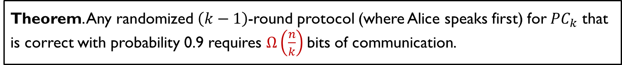
Discussion
More generic density restoring partition?
Open question: Can we prove parity not in AC0 using a top-down approach?
[RSS’ FOCS 23] gave a proof for depth 4 circuits.
Round communication trade-off for other problems?
Theorem. Any randomized $\left(k−1\right)$-round protocol (where Alice speaks first) for $PC_{k}$ that is correct with probability 0.9 requires $Ω\left(\frac{n}{k}\right)$bits of communication.

Slide 19
Thanks for listening ☺

Slide 20
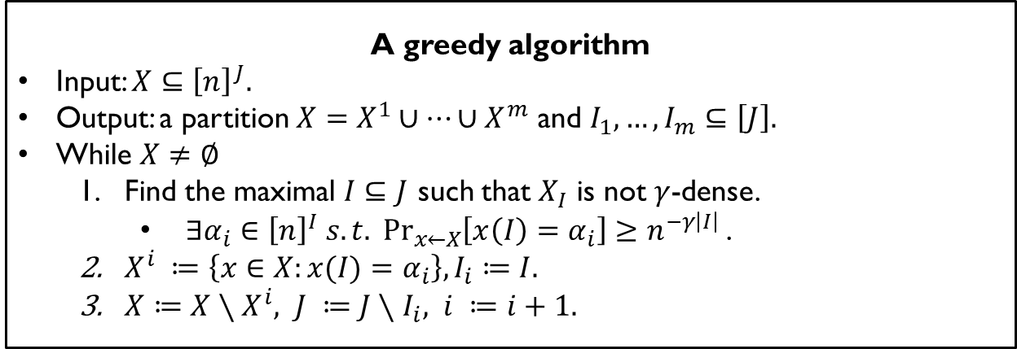
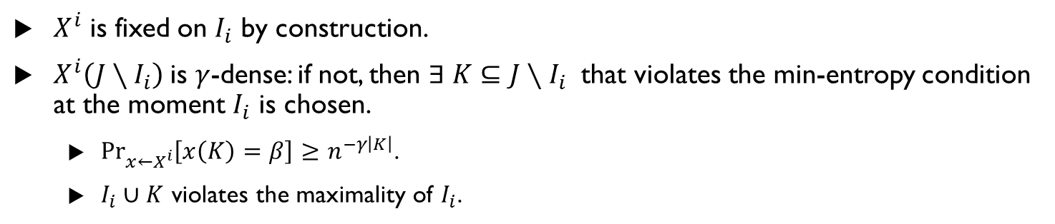
Appendix: Proof of density restoring partition lemma
A greedy algorithm
Input: $X⊆{\left[n\right]}^{J}.$
Output: a partition $X=X^{1}∪⋯∪X^{m}$ and $I_{1},…,I_{m}⊆\left[J\right].$
While $X≠∅$
Find the maximal $I⊆J$ such that $X_{I}$ is not $γ$-dense.
$∃α_{i}∈{\left[n\right]}^{I} s.t. \underset{x←X}{Pr}\left[x\left(I\right)=α_{i}\right]≥n^{−γ\left|I\right|}$.
$X^{i} ≔\left\{x∈X:x(I)=α_{i}\right\}, I_{i}≔I.$
$X≔X∖X^{i}, J ≔J∖I_{i}, i ≔i+1.$
$X^{i}$ is fixed on $I_{i}$ by construction.
$X^{i}\left(J∖I_{i}\right)$is $γ$-dense: if not, then $∃ K⊆J∖I_{i}$ that violates the min-entropy condition at the moment $I_{i}$ is chosen.
$\underset{x←X^{i}}{Pr}\left[x\left(K\right)=β\right]≥n^{−γ\left|K\right|}$.
$I_{i}∪K$ violates the maximality of $I_{i}$.

